Slide 1
High Frequency Stock Analysis
By: Julian Wiley

Slide 2
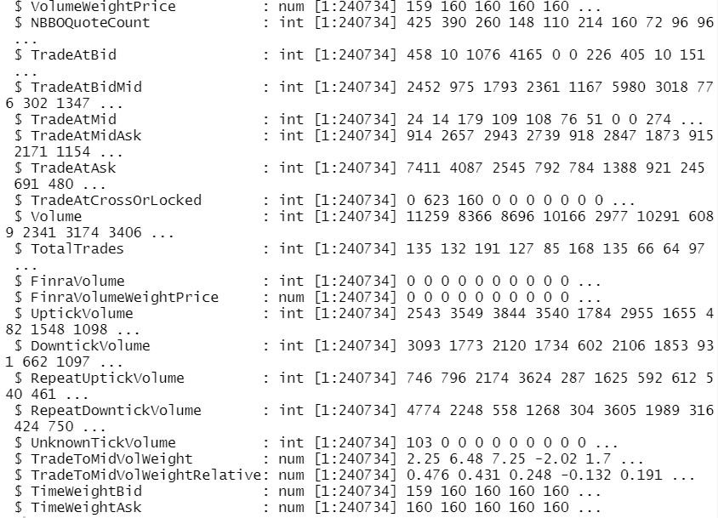
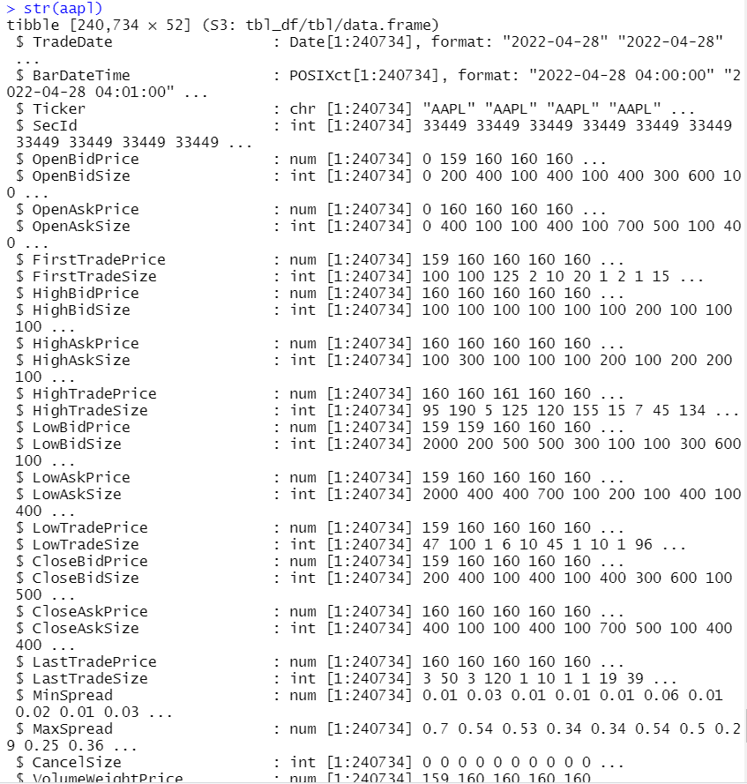
Raw Data
Trade and Quote Dataset – Apple (AAPL)
Trade -> Actual trades
Quote -> Equity Options
Intraday data – 1 min frequency
Non stationary
Calculate indicators for forecasting
Notes:
-

Slide 3
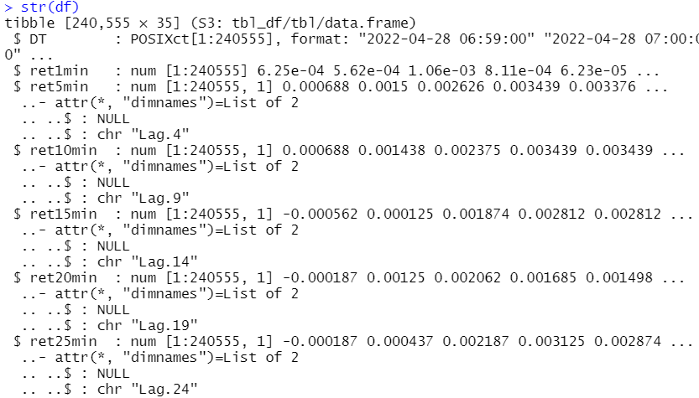
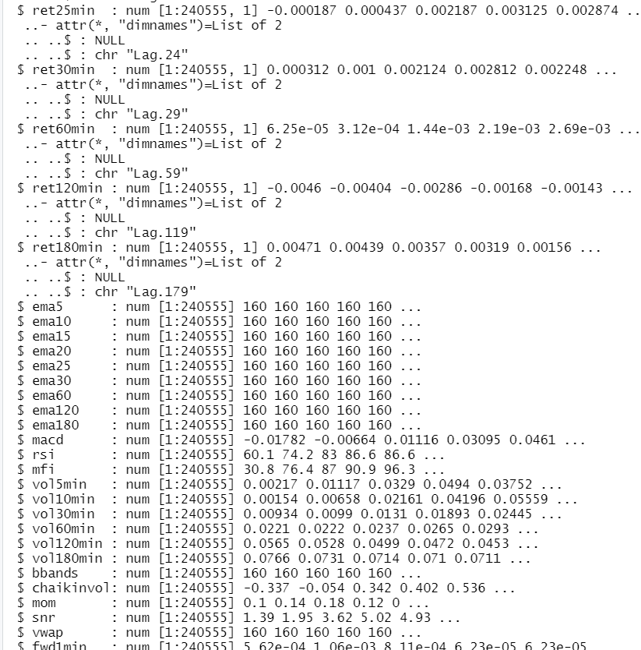
Dataset
Calculated indicators
Intraday, minute frequency
1, 5, 10, 15, 20, 25, 30, 60, 120, 180 min returns
Represents the profits made if one bought AAPL at open price and sold at close
5, 10,15,20,25,30,60,120,180 min Exponential Moving Averages (EMA)
Volatility of 5, 10 , 30, 60, 120, 180 minute returns
Technical Analysis Indicators
Moving Average Convergence-Divergence (MACD), Relative Strength Index (RSI), Money Flow Index (MFI), Bolinger Bands (Bbands), Momentum, Signal-to-Noise Ratio (SNR), Volume Weighted Average Price (VWAP)

Slide 4
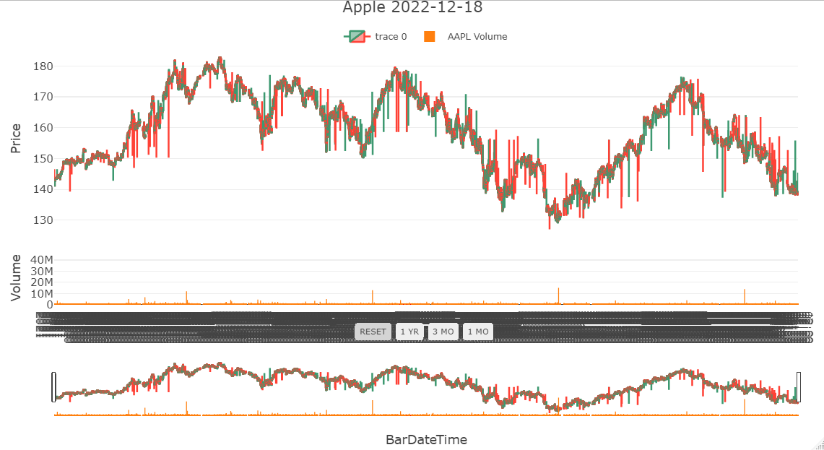
Combined Trade OHLCV Visualization

Slide 5
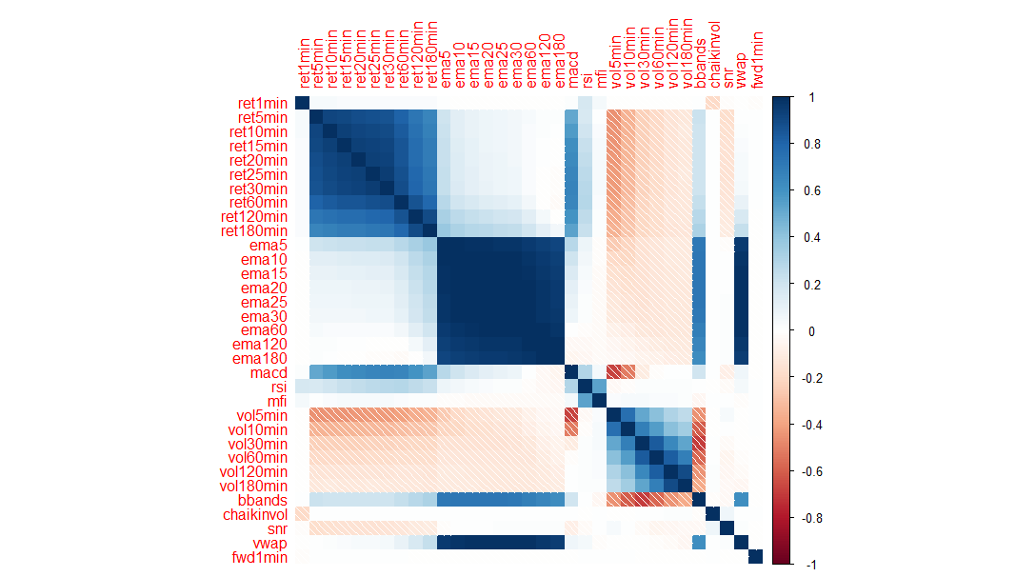
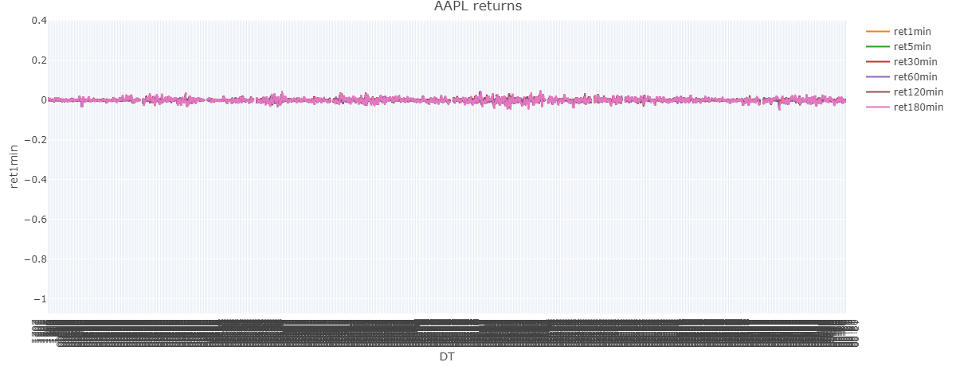
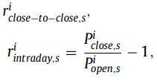
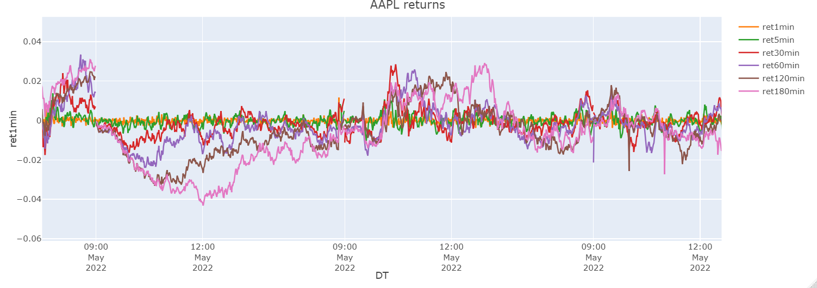
AAPL Returns

Slide 6
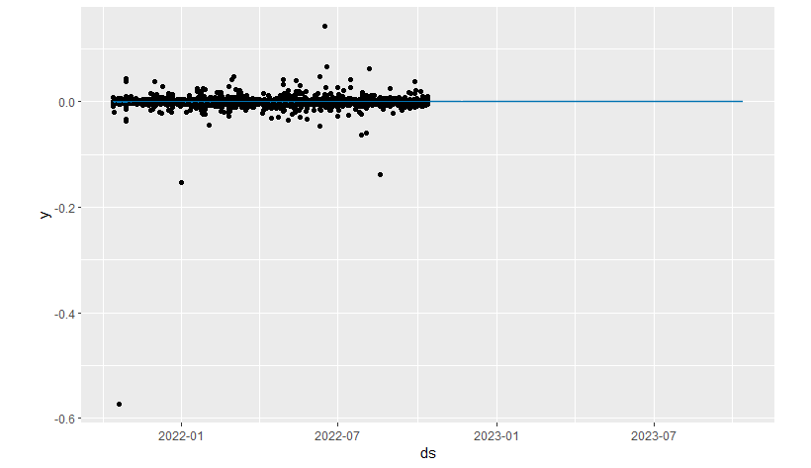
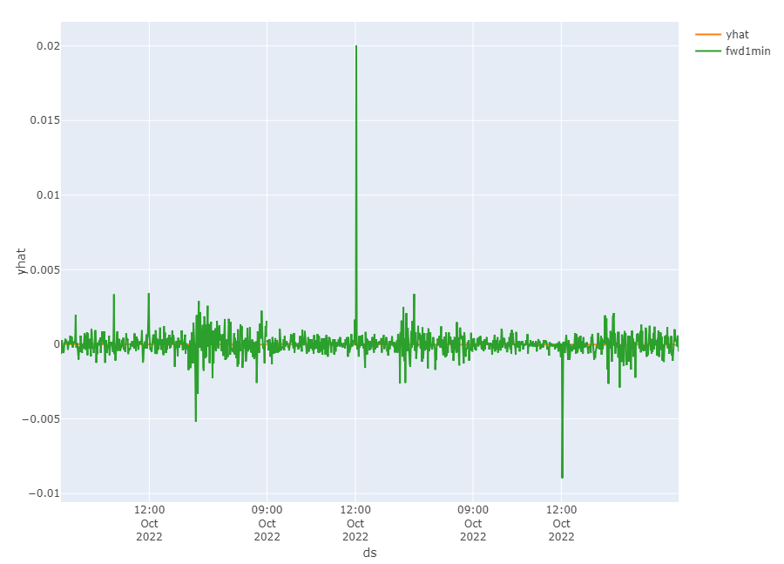
Prophet Forecasts

Slide 7
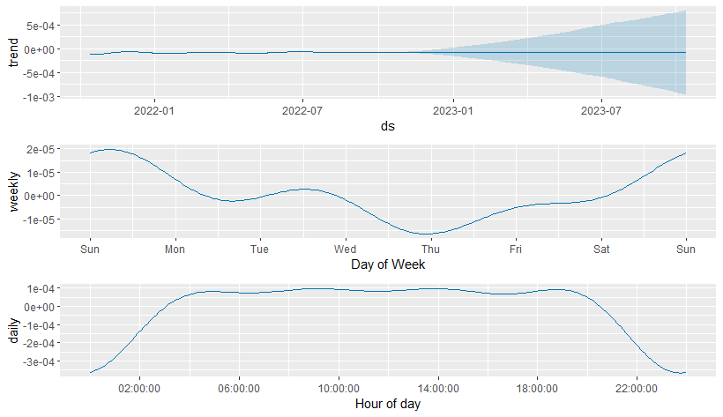
Prophet Components plot

Slide 8
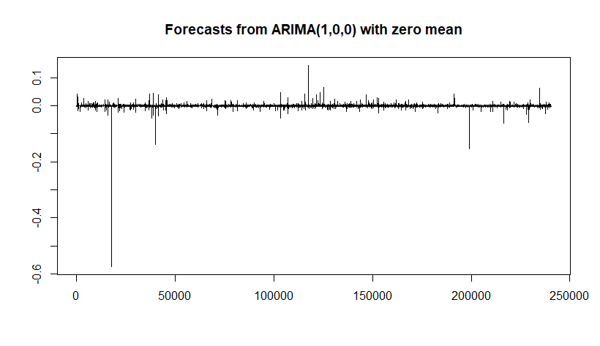
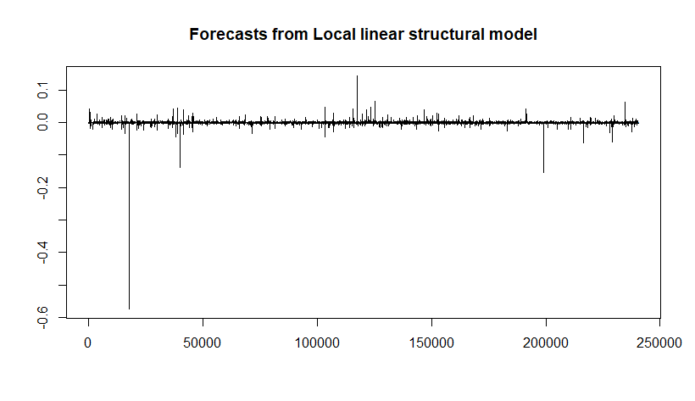
ARIMA and SSM Forecasts

Slide 9
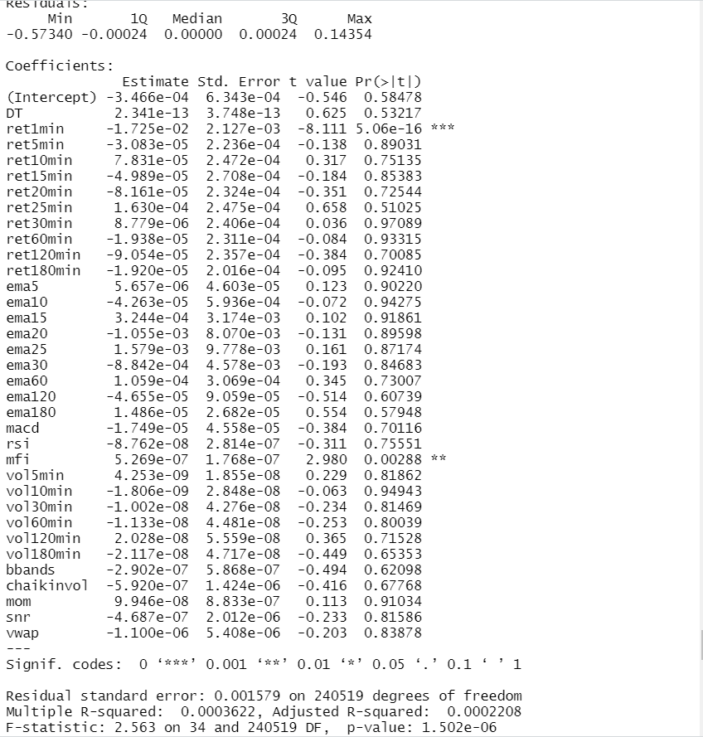
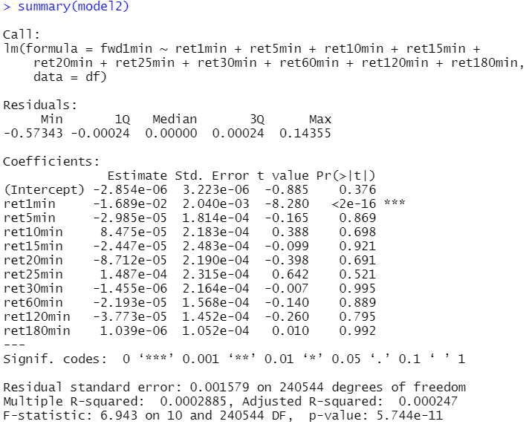
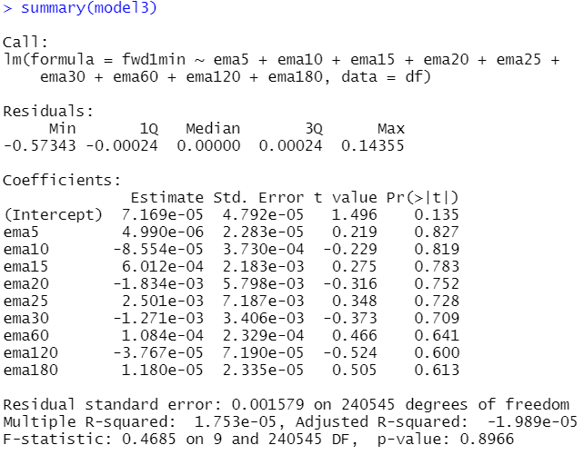
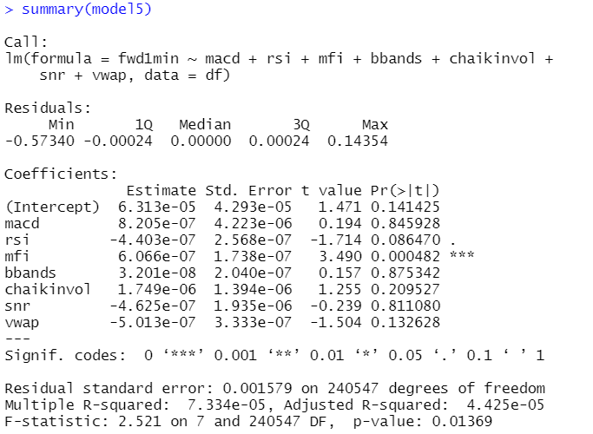
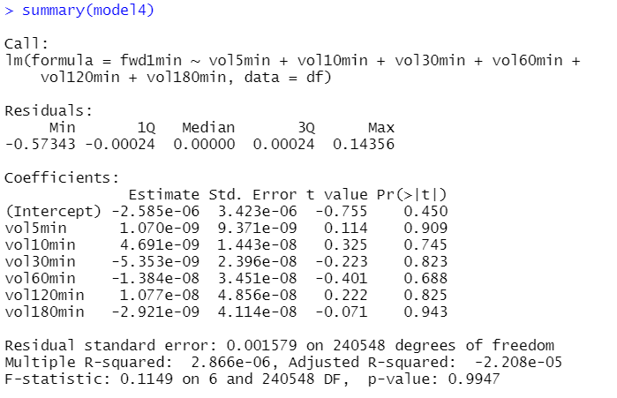
Multiple Linear Regression

Slide 10
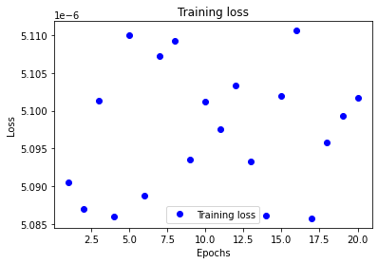
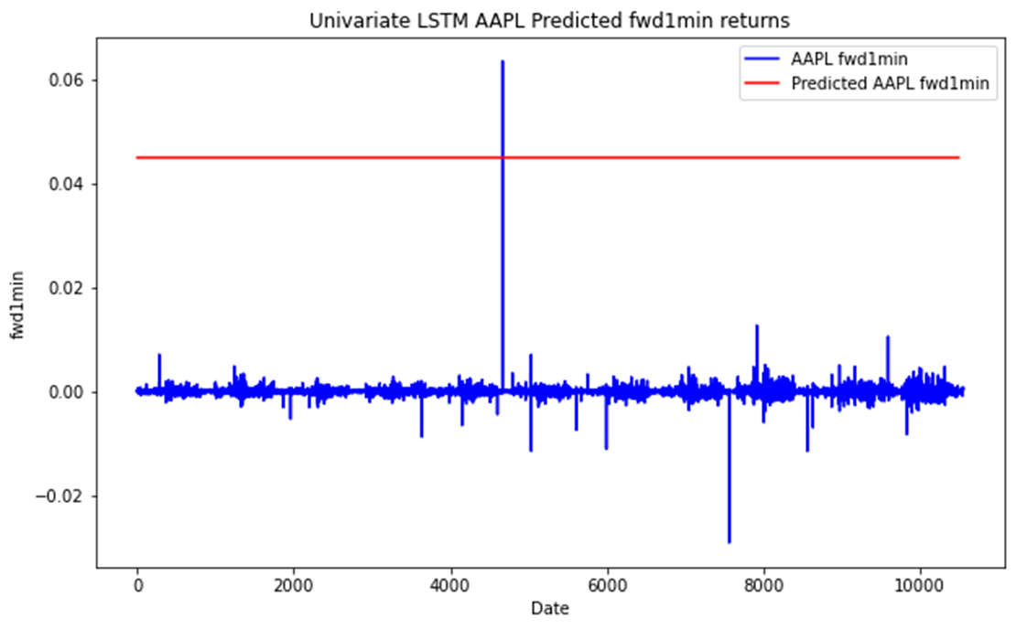
Univariate LSTM

Slide 11
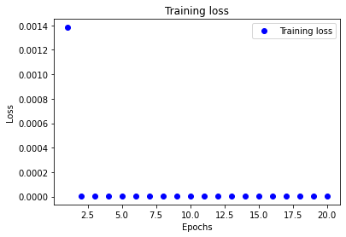
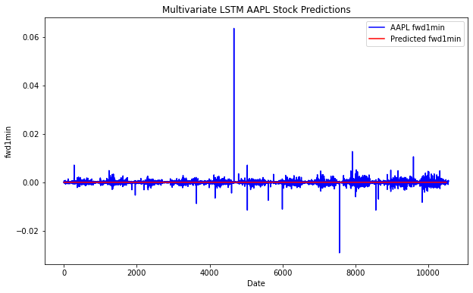
Multivariate LSTM Losses

Slide 12
Results
Model Name | RMSE
Linear Model 1 | 0.0002249
Linear Model 2 | 0.000247
Linear Model 3 | -0.00001986
Linear Model 4 | -0.00002208
Linear Model 5 | 0.00004432
Linear Model 6 | 0.0001923
ARIMA(1,0,0) | 0.0007242055
SSM | 0.0007241101
Prophet | 0.0007595774
Univariate LSTM | 0.0000051017
Multivariate LSTM | 0.0000051013
Notes:
Multiple linear regression was the least successful model likely due to its inability to take into account different structural variations in our time series. Our R2 value was 0.0003662.
ARIMA gave us an RMSE value of 0.0009181449
Structural time series forecasting gave us an RMSE of 0.0009177113.
Prophet gave us an RMSE of 0.0007595774
The univariate LSTM having a RMSE 0.0000051017
The multivariate LSTM having am RMSE of 0.0000051013.
However, we were unable to get these models to forecast returns on the test set.

